Slide 1
Data Collection ——Data Acquisition——
“Data Mining: Methods and Applications”

Slide 2
Contents
Background
Data Acquisition
Data Discovery
Data Augmentation
Data Generation
Data Labeling
Improvement of Existing Data and Models
How to Decide which Data Collection Techniques to Use When
Interesting Future Research Challenge

Slide 3
Data Acquisition
The goal of data acquisition is to find datasets that can be used to mine data.
Three approaches in the literature: data discovery, data augmentation, and data generation.
Data discovery is necessary when one wants to share or search for new datasets and has become important as more datasets are available on the Web and corporate data lakes.
Data augmentation complements data discovery where existing datasets are enhanced by adding more external data.
Data generation can be used when there is no available external dataset, but it is possible to generate crowdsourced or synthetic datasets instead.
Classification of Data Acquisition

Slide 4
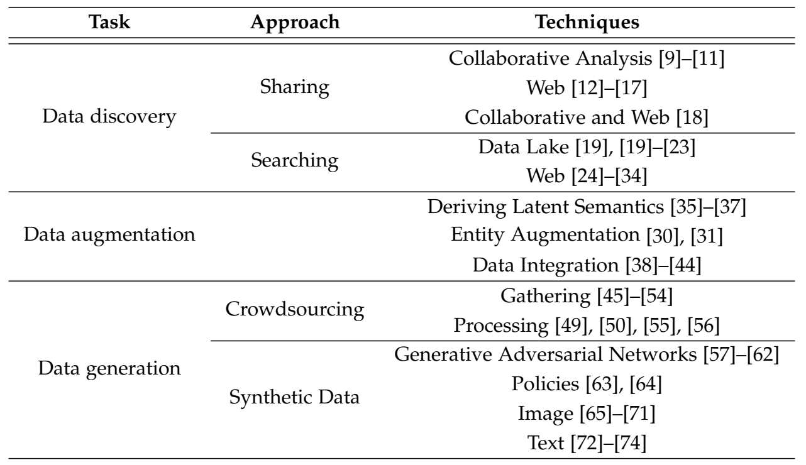
Data Acquisition
A classification of data acquisition techniques. Some of the techniques can be used together.
For example, data can be generated while augmenting existing data.

Slide 5
Data Acquisition——Data Discovery
Two Steps of Data Discovery:
Data sharing: the generated data must be indexed and published for sharing. (Post-hoc Method)
Data searching: search the datasets for the data mining tasks. (how to scale the searching and how to tell whether a dataset is suitable for a given machine learning task)

Slide 6
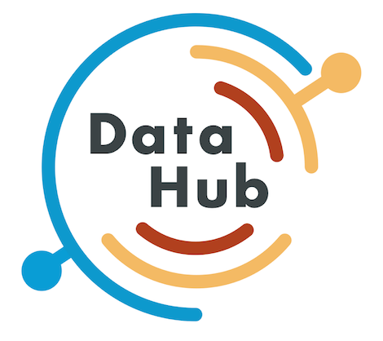
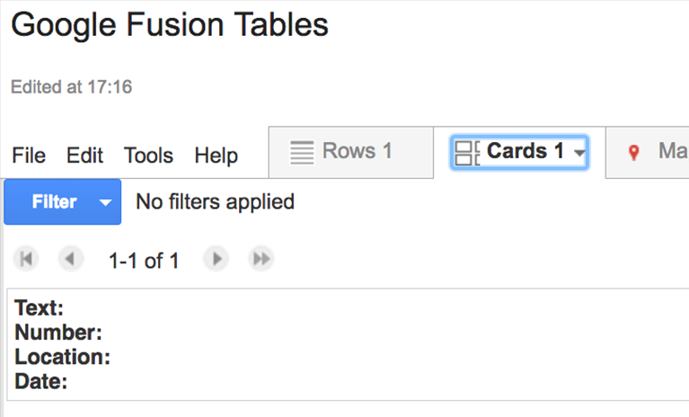
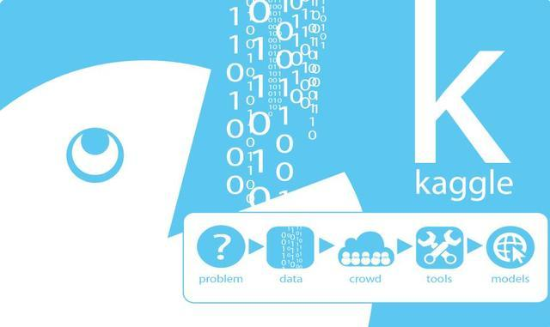
Data Acquisition——Data Discovery
Data Sharing: The data sharing systems are platforms for sharing datasets.
Collaborative Analysis : In an environment where data scientists are collaboratively analyzing different versions of datasets, DataHub can be used to host, share, combine, and analyze them.
2 system components: dataset version control system inspired by Git (a version control system for code) and a hosted platform on top of it, which provides data search, data cleaning, data integration, and data visualization.
Web : A different approach of sharing datasets is to publish them on the Web. Google Fusion Tables is a cloud based service for data management and integration.
Collaborative and Web : Kaggle is a merging of collaborative and Web-based systems

Slide 7
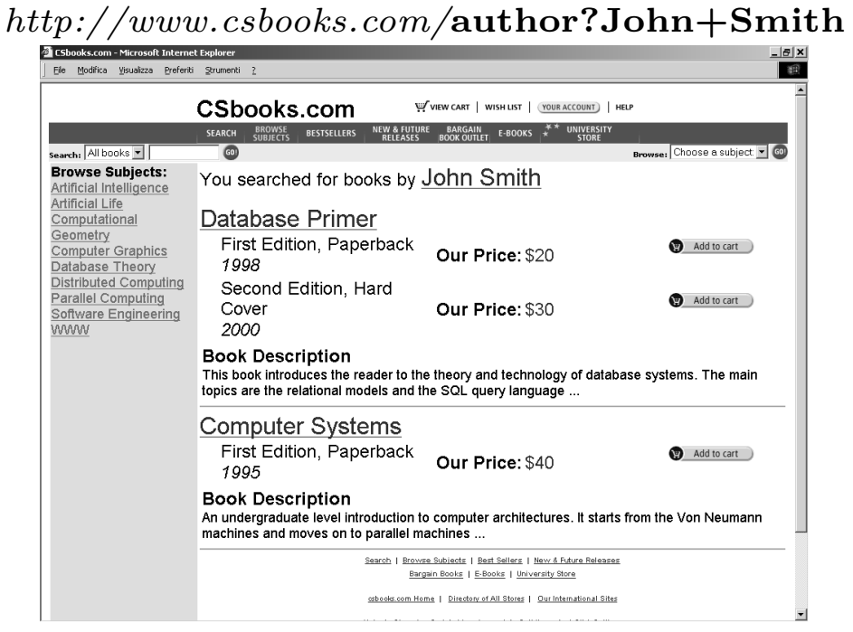
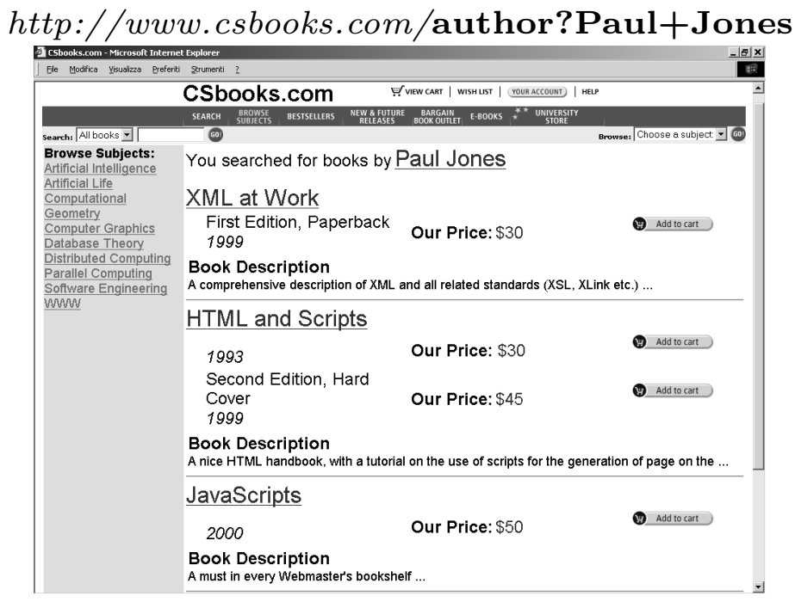
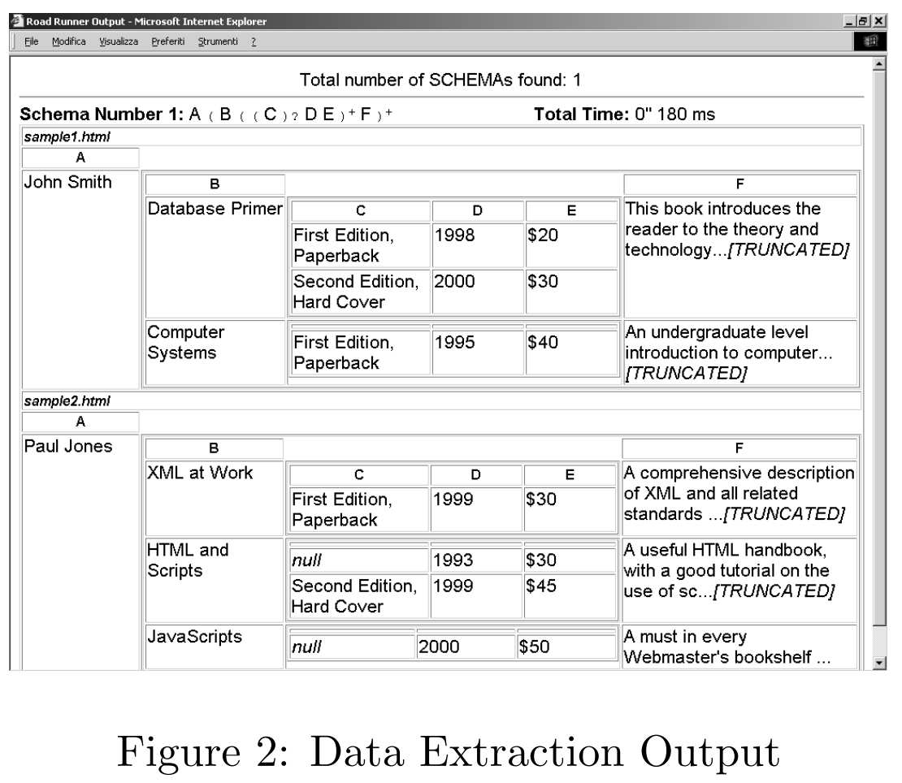
Data Acquisition——Data Discovery
Data Searching: We want to explore systems that are mainly designed for searching datasets.
Data Lake : Providing a way to search datasets and analyze them has significant business value because the teams or individuals do not have to make redundant efforts to re-generate the datasets for their data mining tasks.
IBM estimates that 70% of the time spent on analytic projects is concerned with discovering, cleaning, and integrating datasets that are scattered among many business applications. Thus, IBM takes the stance of creating, filling, maintaining, and governing the data lake where these processes are collectively called data wrangling (数据整理).

Slide 8
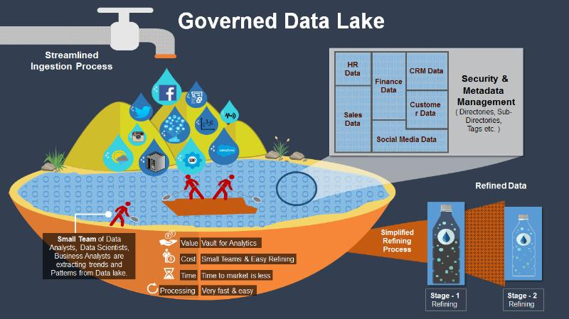
Data Acquisition
Data Lake

Slide 9
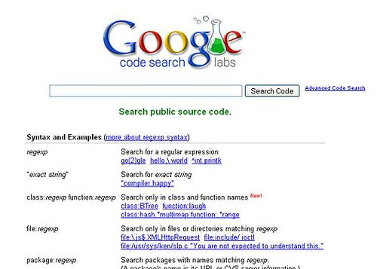
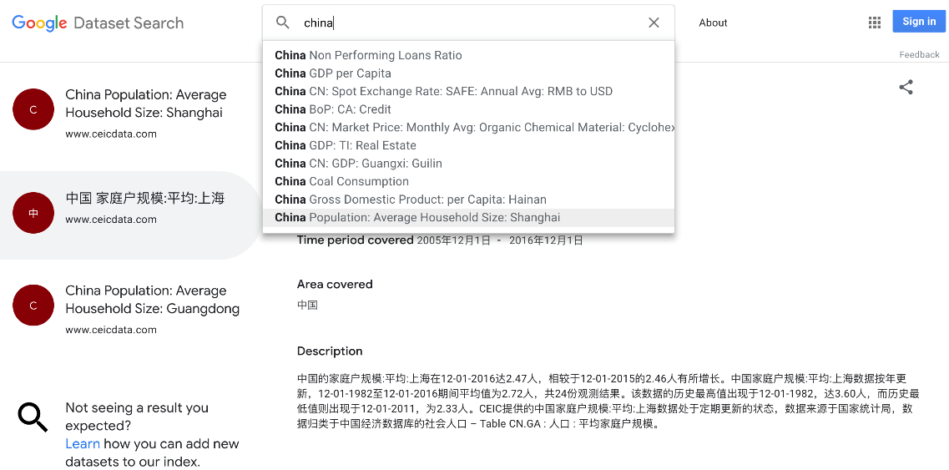
Data Acquisition——Data Discovery
Recently, scalability has become a pressing issue for handling data lakes that consists of most datasets in a large company. Google Data Search (GOODS) is a system that catalogues the metadata of tens of billions of datasets from various storage systems within Google.
Expressive queries are also important for searching a data lake. While GOODS scales, one downside is that it only supports simple keyword queries: The DATA CIVILIZER system, DATARAMAN (discovery queries) and AURUM.

Slide 10
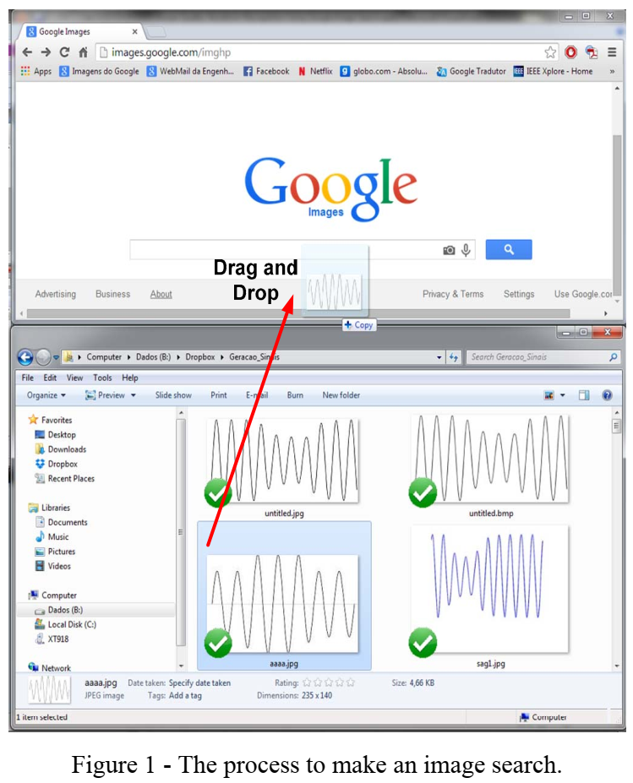
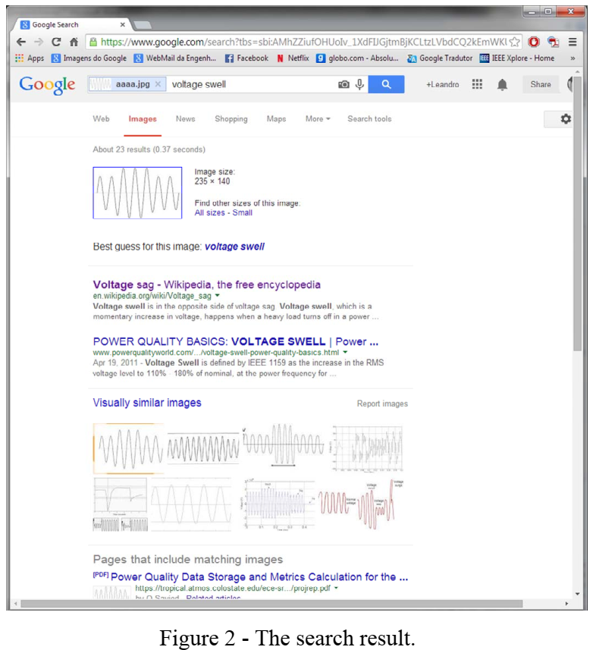

Data Acquisition——Data Discovery
Data Searching
Web : automatically extract the useful ones. WebTables extracts all Wikipedia infoboxes. A service called Google Dataset Search was launched for searching repositories of datasets on Web. The motivation is that there are thousands of data repositories on the Web that contain millions of datasets that are not easy to search.
In comparison to GOODS, Dataset Search targets the Web instead of a data lake.
Google Image Search

Slide 11
Data Acquisition——Data Augmentation
Data Augmentation: Another approach to acquiring data is to augment existing datasets with external data.
Adding pre-trained embeddings is a common way to increase the features to train on.
Entity augmentation techniques have been proposed to further enrich existing entity information.
Data integration is a broad topic and can be considered as data augmentation if we are extending existing datasets with newly-acquired ones.
Deriving Latent Semantics
General Language Model: Word2Vec（CBOW，Skip-gram），GloVe, Doc2Vec.
Latent Topic Modeling: Latent Dirichlet Allocation (LDA)
Entity Augmentation
Octopus and InfoGather

Slide 12
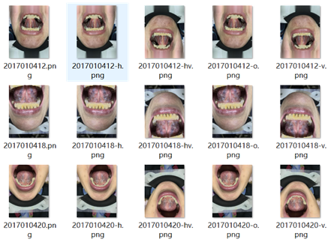
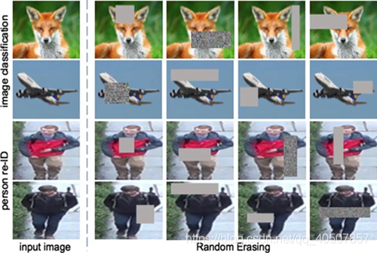
Data Acquisition——Data Augmentation
Data Integration: especially if we are extending existing data sets with other acquired ones.
Hamlet System, Hamlet++ systems

Slide 13
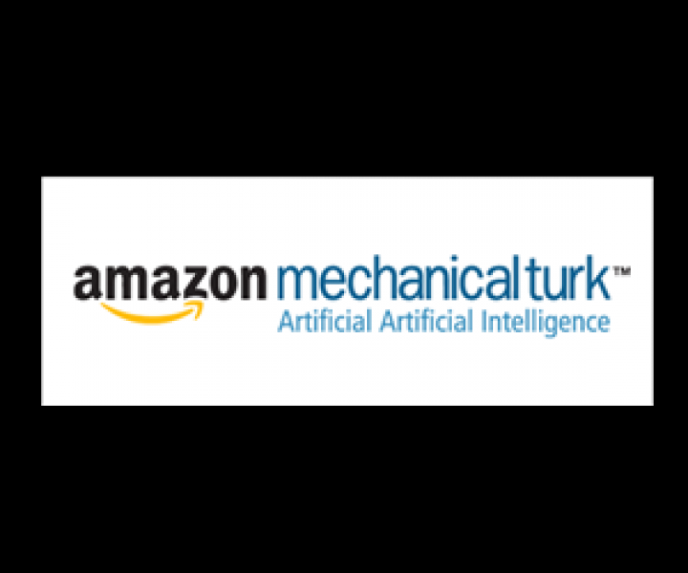
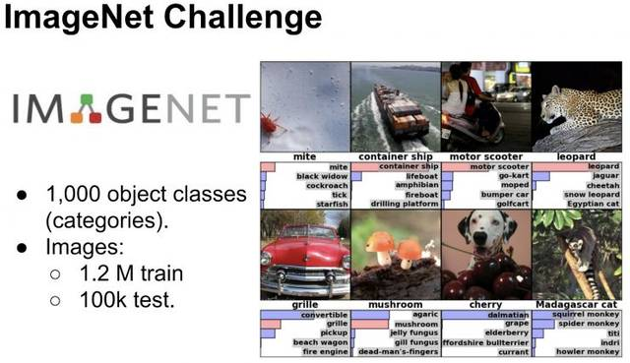
Data Acquisition——Data Generation
Data Generation: If there are no existing datasets that can be used for training, then another option is to generate the datasets either manually or automatically.
Manual Construction : crowdsourcing (众包)
Automatic Techniques
Crowdsourcing: Amazon Mechanical Turk (HITs) and ImageNet Project
Data generation using crowdsourcing can be divided into two steps: gathering data and preprocessing data.
Data gathering : is not limited to collecting entire records of a table.
Preprocessing data : Once the data is gathered, one may want to preprocess the data to make it suitable for machine learning purposes.
For both gathering and preprocessing data, quality control is an important challenge as well.

Slide 14
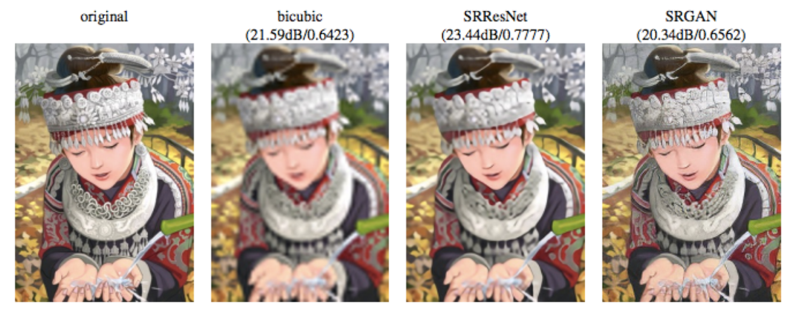
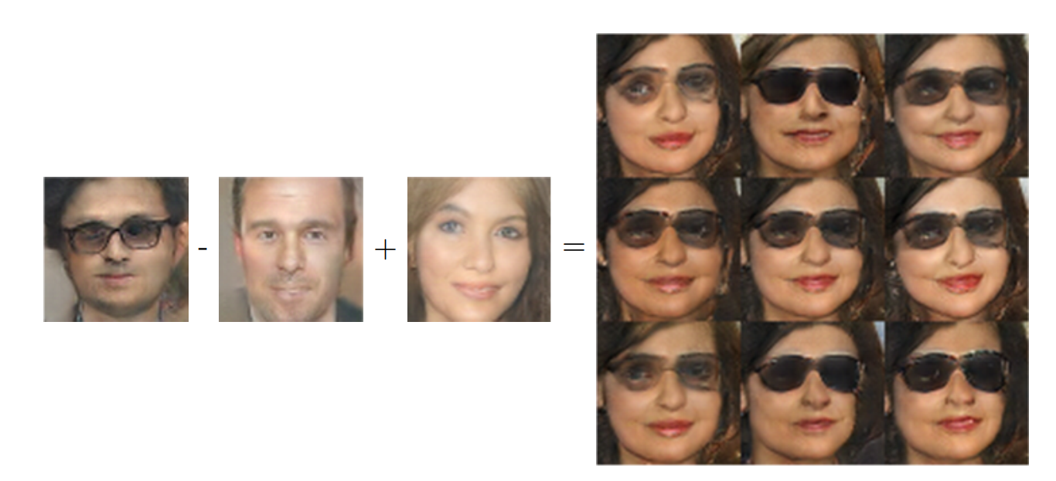
Data Acquisition——Data Generation
Synthetic Data Generation : low cost and flexibility
Generative Adversarial Networks(GANs)
Application-specific generation techniques
GANs The key approach of a GAN is to train two contesting neural networks: a generative network and a discriminative network. The generative network learns to map from a latent space to a data distribution, and the discriminative network discriminates examples from the true distribution from the candidates produced by the generative network.

Slide 15
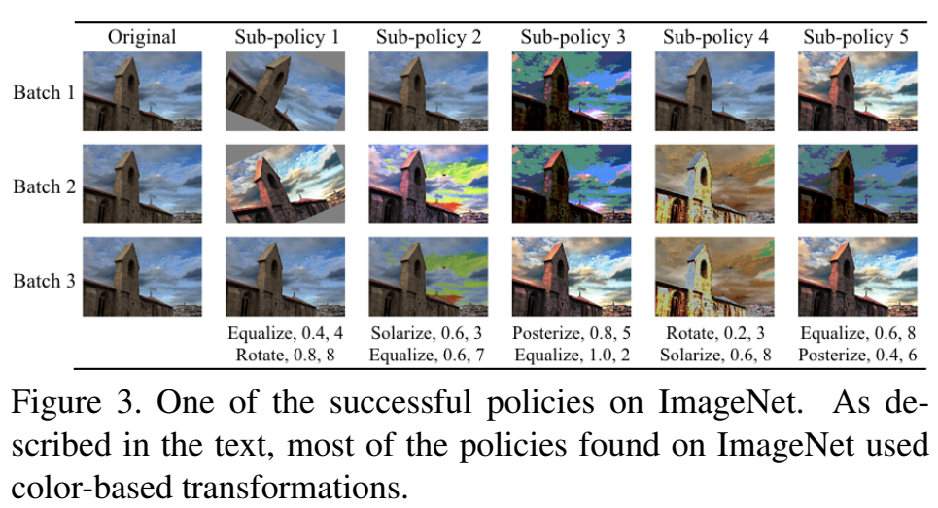
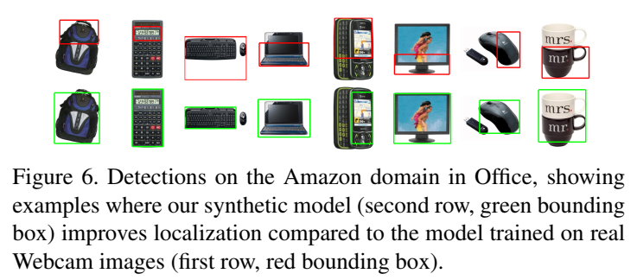
Data Acquisition——Data Generation
Policies Another recent approach is to use human-defined policies to apply transformations to the images as long as they remain realistic.
Data-specific :We now introduce data-specific techniques for generation. Synthetic image generation is a heavily-studied topic in the computer vision.

Slide 16
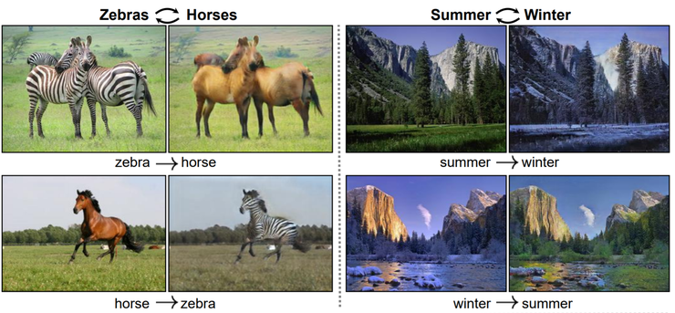

Data Acquisition——Data Generation

Slide 17

Data Acquisition——Data Generation
抖音“吗咿呀嘿”特效图

Slide 18

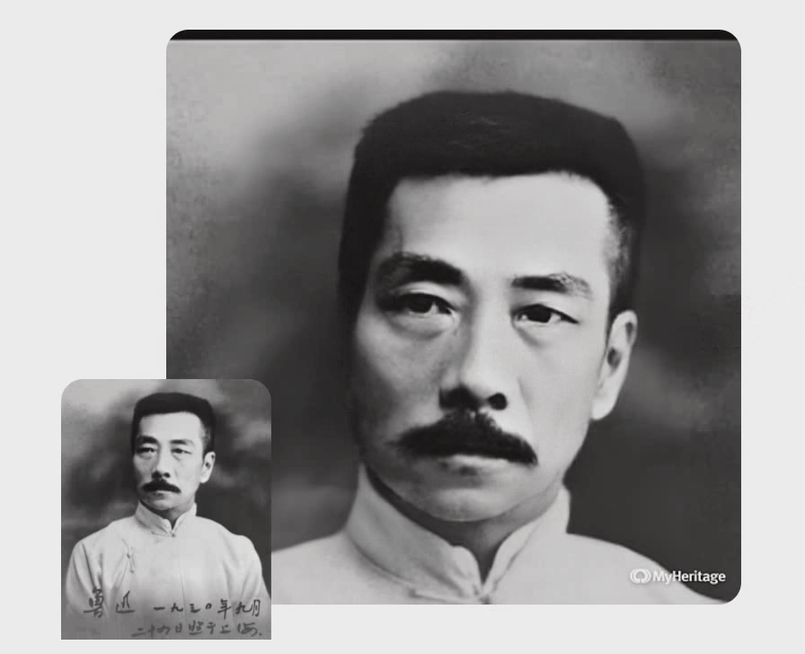
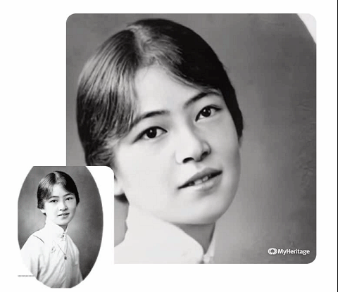
Data Acquisition——Data Generation
MyHeritage 网站 深度怀旧项目

Slide 19
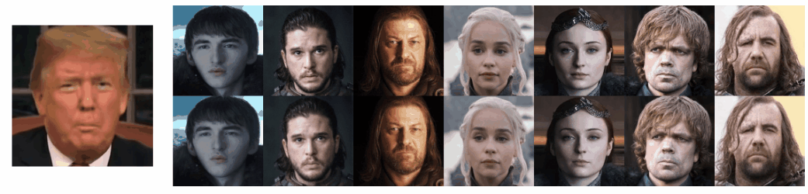
Data Acquisition——Data Generation
MyHeritage 网站 深度怀旧项目

Slide 20

Data Acquisition——Data Generation
AI Data Generation（2022 MIT Technology Review）

Slide 21
Contents
Background
Data Acquisition
Data Labeling
Improvement of Existing Data and Models
How to Decide which Data Collection Techniques to Use When
Interesting Future Research Challenge

Slide 22
Thanks！
Notes:
工作新意图发现

